Slide 1

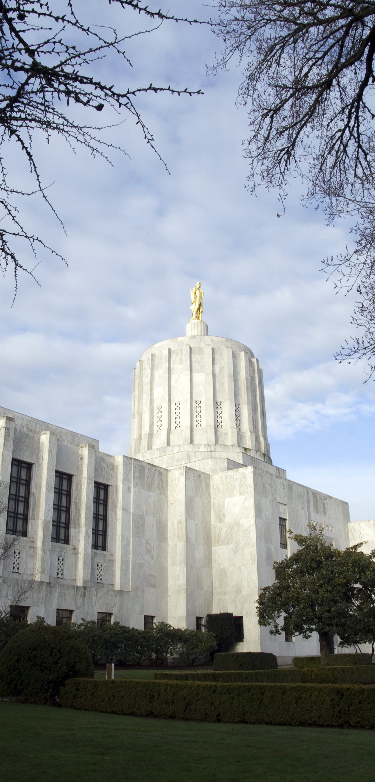
OREGON LEGISLATIVE UPDATE
Review of the 2019 Regular Session
Jay Richardson, CPA, JD, CMA, CFM, CGMA
2019-20 Vice Chair, OSCPA Legislative Policy
Strategic Committee
2019 Oregon Legislative Assembly & OSCPA Activities
  Session began January 22, 2019 and ran through Sine die on June 30, 2019
  Busiest session for CPAs in recent history

Slide 2
  CPAs reviewed 265 tax bills and 20 non-tax bills between January 22nd and June 30th
    Significantly, OSCPA volunteers dealt with an increased number of “touches” and “re-reviews” on bills this session
      Always high activity for committee members and OSCPA Legislative Counsel and OSCPA staff
    Why even more this year?
    Bill amendments require “re-review” by OSCPA volunteers and based on the bill, may require testimony or other internal or external actions or activity
    The number of amendments were significant on some bills such as original HB 3427 – Commercial Activities Tax (CAT) with 32 amendments. Plus, “related” HB 2164 with 26 amendments.

Slide 3
  Rolling Reconnect – Important to members in Business & Industry and to Firms
    SB 212 (Rolling Reconnect) – several bills threated but ultimately it was signed into law by Gov. Kate Brown on June 11, and effective on the 91st day post adjournment.
    OSCPA Strategic Taxation Committee faced numerous bills seeking to disconnect from Federal Tax Code thus stepping away from conformity.
    Committee members responded and testified oftentimes on short notice even during tax season.

Slide 4
  Oregon Passed Centralized Partnership Audit Regime (CPAR) Legislation
    Oregon – One of only five states in the US to pass new CPAR legislation during 2019 Spring legislative sessions.
      Based on national model language from Multistate Tax Commission.
      OSCPA worked in cooperation with AICPA, Oregon Department of Revenue (DOR), Council on State Taxation (COST) and Moss Adams.
      Thank you to Moss Adams for providing technical expertise and practitioner perspective.

Slide 5
  Update on Recent Activities Related to the Commercial Activities Tax (CAT)
    OSCPA has been working on various projects to assist you
    We held several educational sessions in late summer/early fall – more to come!
    Oregon Department of Revenue (DOR) held practitioner input sessions around the state in the fall.
      Additionally, OSCPA produced two DOR panelist input webinars for members that did not have a live DOR session scheduled in their area. This included Eastern Oregon, Southeastern Oregon and Oregon coast, plus for others who wished to participate.

Slide 6
  Update on Upcoming Activities Related to the Commercial Activities Tax (CAT)
    Currently, DOR is working on Oregon Administrative Rules. Rulemaking in process into January-March 2020.
    We anticipate adding more CAT training (CPE) and sharing details as rules are finalized.
    Upcoming: OSCPA State and Local Tax (SALT) Conference on January 6, 2020.
      DOR staff will be presenting on the topic of “Oregon New Tax Law Update”
      Larry Brant, Attorney, with Foster Garvey PC, Portland, will be presenting on “The Oregon Corporate Activity Tax.”
      The conference will be available in-person as well as via individual and group web-cast to ensure statewide access.

Slide 7
  Key to Our Success – OSCPA Committees Working Together with Legislative Counsel and OSCPA Staff!
    OSCPA Strategic Taxation Committee
      Due to bulk of bills and required monitoring, members sign up weekly to review bills during session
        Backup reviewers support primary to balance load
        Non-committee OSCPA members support as backups too!
        No need to join the committee to assist. Call President/CEO Sherri McPherson to get involved – a little or a lot – it all helps
        Great way to stay current and to build depth in your firm or business
      Plus…

Slide 8
    OSCPA Governmental Strategic Committee members respond to accounting related bills
    OSCPA Not-for-Profit Strategic Committee members respond to accounting related bills
    OSCPA Legislative Policy Strategic Committee members respond to, and may advance, accounting related bills
    And, “Ad hoc” members that jump in where and as needed!

Slide 9
  OSCPA Members as a Trusted Resource to the Oregon Legislature on Technical Tax Issues
    Legislative Analysis “Reconnect” Publication – Annual conformity publication developed by the OSCPA Taxation Legislative Analysis Subcommittee for use by the Oregon Legislature’s revenue committees
    Testimony and Technical Guidance – OSCPA Taxation Legislative Analysis Subcommittee members responded and testified on Reconnect and other bills oftentimes on short notice – even during tax season.
      They also provided technical feedback to legislators.
      Of value to the Legislature, CPAs can easily share technical information and provide feedback in an easy to understand manner due to the work they do in their own businesses or practices.

Slide 10
  Advocacy Counts!
    2019 OSCPA Legislative Report – Sent to each member in format based on preference of email or printed version.
      Another copy is provided in your materials today.
      OSCPA website access:
        https://www.orcpa.org/news-resources/6:legislative-reports-and-updates/publication-detail
    Key Person – Do you know an Oregon or US Legislator? Please advise President/CEO Sherri McPherson. In addition to our efforts in Salem, we also connect with US Senators and Representatives. We make Capitol Hill visits as well. Your feedback could make a difference!
    Advocacy – Your involvement and contributions the OCPA/Legislative Action Committee make a difference!
        https://www.orcpa.org/advocacy

Slide 11
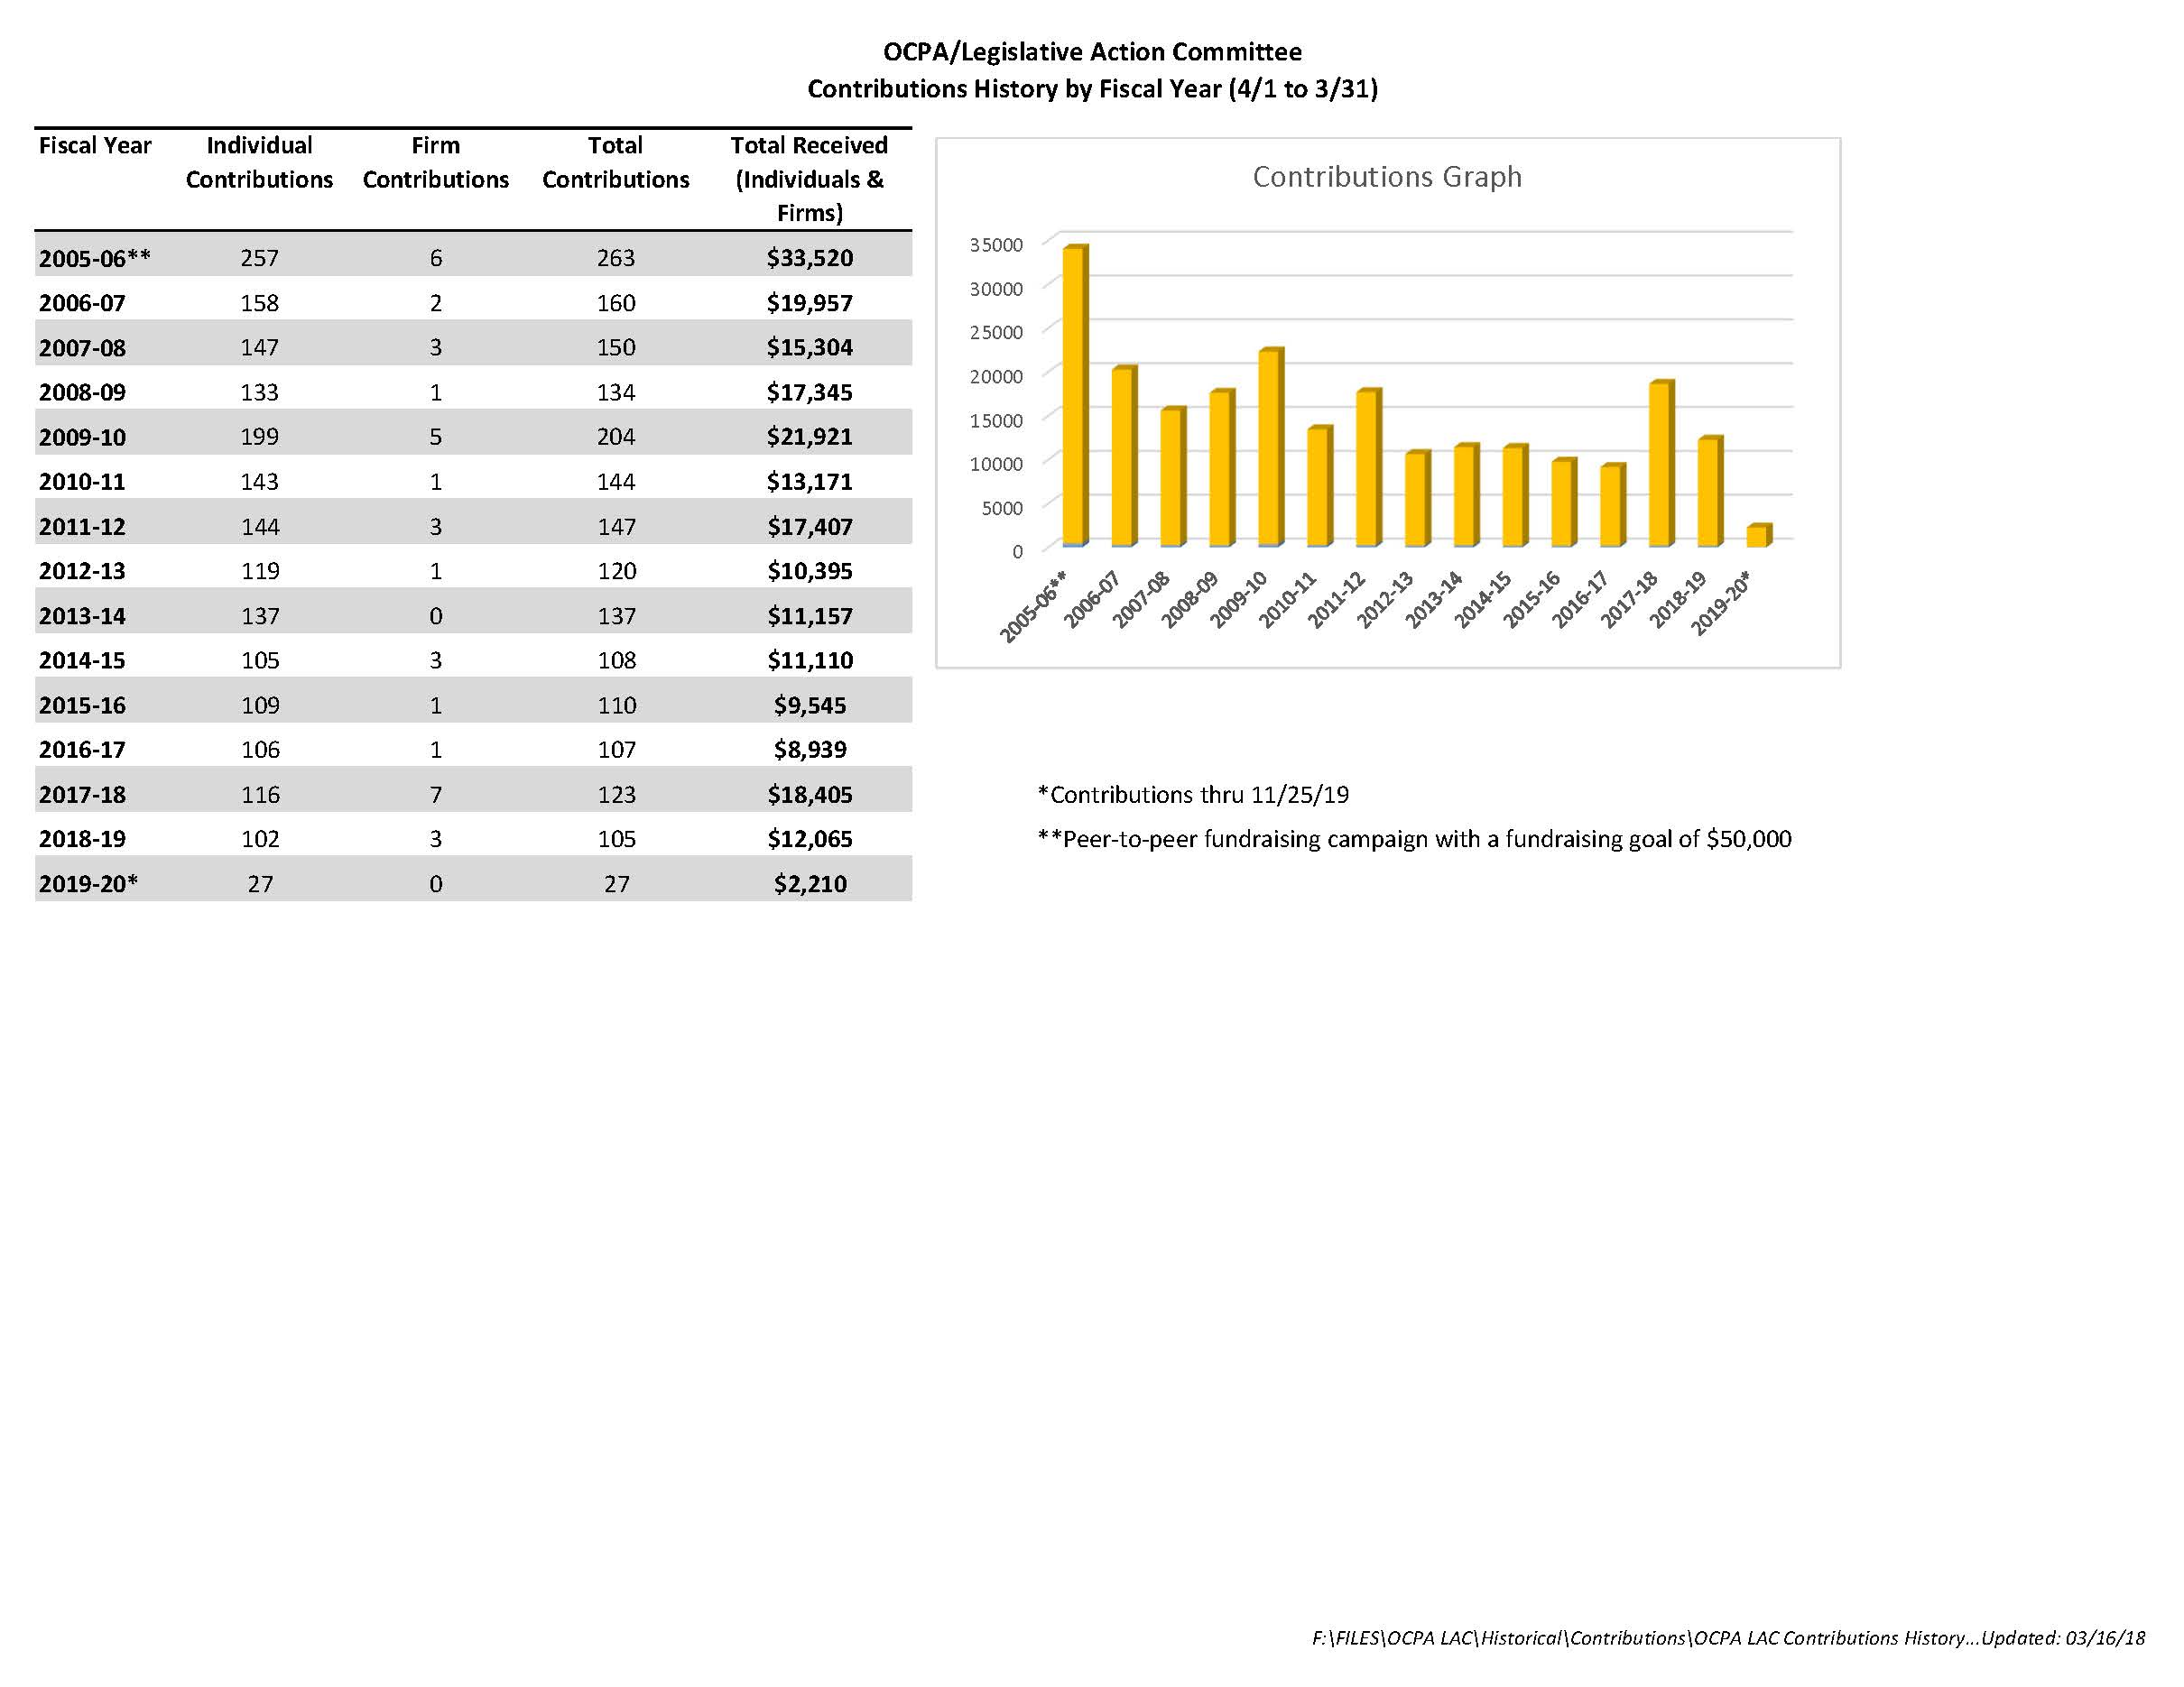

Slide 12

Thank you!

